Slide 1
Empowering Human Rights Advocacy through Communication
Developed by Arrabal-AID

Slide 2
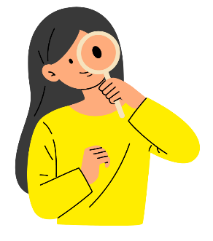
Index
Unit 1. Fundamentals of Human Rights
1.1. Unalienable rights
1.2. Indivisible and interdependent rights
1.3. The Role of Communication in Protecting Rights
Unit 2. Communication-Related Rights Violations
2.1. Censorship
2.2. Disinformation
2.3. Privacy Violations
Unit 3. Defending Human Rights Through Communication
3.1. Digital activism.
3.2. Awareness campaigns.
3.3. Powerful narratives.

Slide 3
Learning outcomes
In this module, you will learn:
Understand the fundamental concepts of human rights and their relationship to communication.
Identify how communication can protect or violate human rights.
Recognize examples of violations of rights related to communication.
Use communication strategies to promote and defend human rights.
Develop skills for the active defense of human rights through campaigns and media.

Slide 4
1. Fundamentals of Human Rights
This module addresses the basic principles of human rights, which are the fundamental freedoms and protections that every person is entitled to, simply by virtue of being human. These rights are universal, meaning they apply to all individuals without discrimination based on nationality, ethnicity, gender, religion, or any other characteristic. They are rooted in the belief that all human beings are born free and equal in dignity and rights, a concept that transcends borders, cultures, and legal systems.
Human rights have been formalized in key international agreements, the most notable being the Universal Declaration of Human Rights (UDHR), adopted by the United Nations General Assembly in 1948. The UDHR outlines 30 articles that articulate the rights and freedoms to which all people are entitled. These include civil, political, social, economic, and cultural rights, and they serve as the foundation for international human rights law. Among the key rights emphasized in the declaration are:
Freedom: The right to live freely, without fear of oppression or arbitrary imprisonment.
Equality: The right to equal treatment before the law and protection from discrimination.
Dignity: The recognition of the inherent dignity of all human beings and the need for respectful treatment, free from abuse or exploitation.

Slide 5
1. Fundamentals of Human Rights
The UDHR set a global standard for human rights, but its principles have since been expanded upon in legally binding treaties and conventions, such as the International Covenant on Civil and Political Rights (ICCPR) and the International Covenant on Economic, Social, and Cultural Rights (ICESCR). Together, these documents form what is often referred to as the International Bill of Human Rights. These instruments hold nations accountable for ensuring the protection of human rights within their jurisdictions.
Human rights are not just legal principles; they are intertwined with communication and freedom of expression. Communication plays a critical role in the exercise, protection, and promotion of human rights. Freedom of expression, the right to access information, and the right to privacy are central to ensuring that individuals can fully enjoy their rights. Without the ability to freely communicate or access information, other rights, such as the right to participate in public life, the right to education, or the right to work, are significantly compromised. In this way, human rights are interconnected—one cannot be fully enjoyed without the protection of others.
For example, freedom of expression is a cornerstone of democracy and is essential for holding governments accountable, exposing human rights violations, and enabling public participation in decision-making processes. Similarly, the right to privacy is crucial in protecting individuals from undue interference by the state or other entities, and it is particularly relevant in today's digital age, where personal data can be easily exploited. Access to information is another essential right, as it ensures that individuals can make informed decisions about their lives, participate in society, and advocate for their rights. Without access to accurate information, people's ability to exercise other rights—such as voting, education, or health—can be severely limited.

Slide 6
1. Fundamentals of Human Rights
Communication, therefore, not only serves as a mechanism for the exchange of ideas and the dissemination of knowledge, but also acts as a protective shield for human rights. Media outlets, journalists, activists, and digital platforms play an indispensable role in making injustices visible, amplifying marginalized voices, and promoting equality and inclusion. Yet, while communication can be a powerful tool for advancing human rights, it can also be used to infringe upon them. Misuse of communication tools—through censorship, disinformation, or surveillance—can result in significant rights violations, further underscoring the need for responsible communication practices.
In sum, the basic principles of human rights are universal, indivisible, and interrelated. They are designed to ensure that all people can live in freedom, with dignity and equality. Communication is a key component in this framework, acting as both a facilitator and a protector of these fundamental rights. By promoting open dialogue, accurate information, and respect for privacy, communication supports the broader human rights agenda, helping to create societies where rights are recognized, respected, and upheld for all.

Slide 7
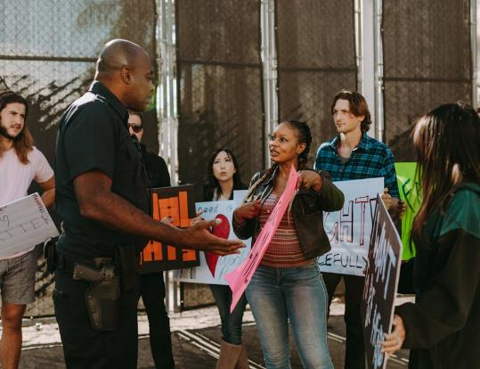
1. Fundamentals of Human Rights 1.1. Unalienable rights
They cannot be removed or transferred. Human rights are inalienable, meaning that no person can be stripped of them, not even by their own consent. They do not depend on the will of governments or any authority; they are inherent to all human beings from birth. For example, the right to life or the right not to be tortured cannot be suspended or negotiated, even in extreme situations such as armed conflict. This principle ensures that everyone enjoys a minimum level of protection in any circumstance.
Example: In some countries, even during national emergencies like war or unrest, the right to life and the prohibition against torture remain inviolable, ensuring basic human dignity.

Slide 8
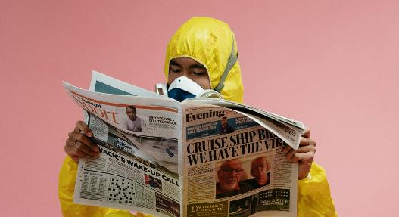
1. Fundamentals of Human Rights 1.2. Indivisible and interdependent rights
All rights are connected and the enjoyment of one depends on respect for others. The indivisibility of human rights means that they cannot be ranked; no right is more important than another, as all are interconnected. Interdependence refers to the fact that the enjoyment of one right depends on respect for others. For example, for a person to fully enjoy their right to health, they also need access to reliable information (right to information) and to live in a safe environment (right to security). This underscores the need for a comprehensive approach to ensure the respect of all human rights.
Example: A community’s right to health during a pandemic depends on access to reliable information (right to information), which allows them to make informed decisions for their safety.

Slide 9
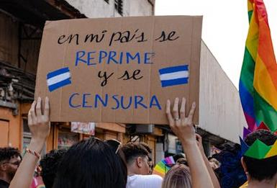
1. Fundamentals of Human Rights 1.3. The Role of Communication in Protecting Rights
Communication is crucial for making injustices visible and promoting equality, as media and digital platforms enable the reporting of rights violations and help raise awareness. However, they can also be used to spread misinformation, incite hatred, or limit access to vital information, which can perpetuate discrimination or justify human rights abuses. Example: A journalist reporting on human rights violations in a dictatorship is exercising their right to freedom of expression and, in turn, allowing other citizens to exercise their right to information.
Example: A reporter who reports on human rights violations in a dictatorship is therefore exercising his right to freedom of expression and helping others to
become informed, thereby exercising his right to information.

Slide 10
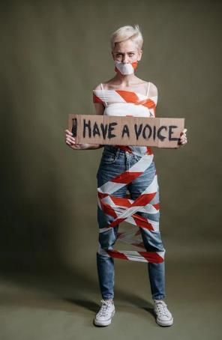
2. Communication-Related Rights Violations
This module explores how human rights can be violated through communication. Common violations include censorship, disinformation, and invasion of privacy, all of which undermine fundamental rights. Disinformation, in particular, is a serious problem in the digital age, as it can erode public trust, distort reality, and foster hatred or violence, which negatively impacts the right to non-discrimination and security. Communication-related rights violations are especially dangerous because they affect people’s ability to make informed decisions and fully participate in society.
Example: In some countries, social media is blocked or internet services are cut off during public demonstrations, limiting the right to freedom of expression and access to information. In addition, discrimination in the media, such as disproportionate coverage of certain groups, generates stigmatisation, affecting the equality and dignity of individuals.

Slide 11
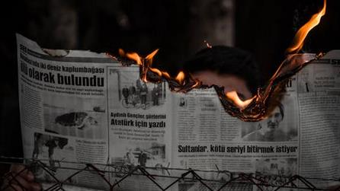
2. Communication-Related Rights Violations 2.1. Censorship
Prohibition or control of information by the State or other entities. Censorship occurs when the state, powerful groups, or even private platforms restrict or control the dissemination of information, violating the right to freedom of expression and access to information. This can involve blocking news, removing critical content, or manipulating the media. Censorship can have severe consequences for democracy, as it prevents citizens from accessing crucial information needed to make informed decisions.
Example: In some authoritarian regimes, independent media are silenced, depriving society of knowledge about abuses or corruption.
Another example, in certain countries, media outlets
are shut down or heavily regulated to prevent the dissemination of news critical of the government, depriving the public of information about human rights abuses.

Slide 12
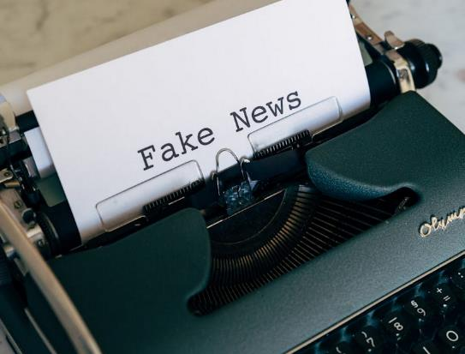
2. Communication-Related Rights Violations 2.2. Disinformation
The intentional dissemination of false or misleading information, which may lead to violations of fundamental rights. Disinformation is the deliberate spread of false or distorted information to manipulate public perception. In the age of social media, disinformation can spread rapidly, eroding trust in institutions and fostering social polarization. Disinformation directly affects people’s right to access truthful and reliable information, which is essential for informed and free decision-making.
Example: During elections, false information about candidates' policies or backgrounds can be circulated on social media, misleading voters and affecting their ability to make informed choices.

Slide 13
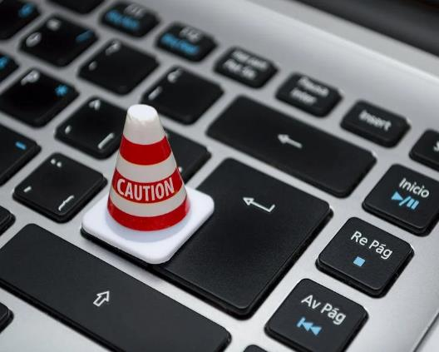
2. Communication-Related Rights Violations 2.3. Privacy Violations
Unauthorized control over personal information and mass surveillance undermine the right to privacy. Invasion of privacy through unauthorized control of personal data or mass surveillance by the state or private companies undermines the right to privacy. Monitoring communications, improper collection of information, and misuse of personal data can infringe on individual autonomy and create a climate of distrust.
Example: In some contexts, governments have implemented mass surveillance of citizens through their mobile devices, violating their right to privacy. In many countries, unauthorized phone tapping and surveillance of political dissidents' social media profiles have led to arrests and intimidation, violating their right to privacy.

Slide 14
3. Defending Human Rights Through Communication
The final module explores on how communication can be a powerful tool to defend and promote human rights. Social media and digital platforms provide global platforms to raise awareness and mobilize society around human rights causes. With these tools, abuses can be reported in real-time, international solidarity movements can be created, and pressure can be applied to governments and responsible entities. Communication is thus essential in the fight for human rights in today’s world.
Example: Amnesty International's global campaign "Write for Rights" has used digital communication to put pressure on governments and free political prisoners, demonstrating the power of communication to achieve real change in the defence of human rights.

Slide 15
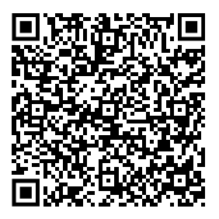
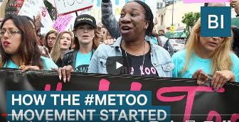
3. Defending Human Rights Through Communication 3.1. Digital activism
Using social media, blogs and other platforms to spread messages in favour of human rights. Digital activism is a key strategy for promoting human rights on a large scale, using social media, blogs, and other online platforms to reach global audiences.
Example: Movements like #BlackLivesMatter and #MeToo have demonstrated the power of digital campaigns to raise awareness, mobilize millions of people, and push for political and social reforms. These campaigns show how digital communication can be an effective tool for systemic change, amplifying marginalized voices and attracting global attention.
Although the hashtag was popularized in 2017 in the audiovisual sector, Tarana Burke started the movement in 2006. It explores the origins of the #MeToo movement and what specific things must change to help victims and prevent cases of sexual assault: https://youtu.be/u1Rb7TGgsp4?si=HcGeRNYdKcQ2xjRK

Slide 16
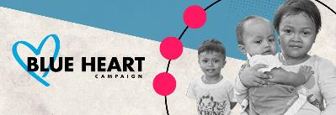
3. Defending Human Rights Through Communication 3.2. Awareness campaings
Using clear and accessible messages to educate the population about rights violations and how to prevent them. Awareness campaigns are crucial for educating the public about human rights violations and how to prevent them. Using clear, accessible, and emotional messages, these campaigns aim to raise empathy and mobilize society to act in defense of people’s rights.
Example: Campaigns against human trafficking have used visual materials and powerful testimonies to illustrate the severity of this crime and encourage collaboration in its eradication. Or a campaign against child labor may include real-life testimonies from affected children, supported by compelling imagery, to illustrate the gravity of the issue and encourage international action.
The Blue Heart Campaign encourages involvement from governments, civil society, the corporate sector and individuals alike to inspire action and help prevent human trafficking. All proceeds of the Blue Heart Campaign go to the United Nations Voluntary Trust Fund for Victims of Trafficking in Persons, especially Women and Children. The Trust Fund provides vital assistance and protection to the victims of trafficking through a network of specialized organizations across the globe: https://www.unodc.org/unodc/en/blueheart/

Slide 17
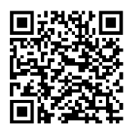
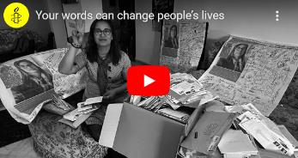
3. Defending Human Rights Through Communication 3.3. Powerful narrative
Telling powerful personal stories is an effective way to raise public awareness and mobilize support for human rights causes. Personal stories, presented through powerful narratives, are an effective means of creating empathy and mobilizing support for human rights causes. When people can emotionally connect with the experiences of those who have suffered rights violations, they are more likely to join the cause and demand justice.
Example: Amnesty International’s global campaign “Write for Rights” has used personal stories of political prisoners to generate international support and pressure for their release.
Do you want participate? Every year, Amnesty International’s Write for Rights campaign brings together people from around the world to fight
injustice and support people whose human rights are under threat. By writing letters, signing petitions and sharing stories, you can demand justice calling decision makers to do the right thing. Join this year’s campaign and become part of a community working to make the world a more just and compassionate place. Join Write for Rights today. https://www.amnesty.org/en/get-involved/write-for-rights/

Slide 18
3. Defending Human Rights Through Communication
The module demonstrate the profound connection between human rights and communication. Human rights are fundamental to the dignity and equality of all individuals, and communication plays a critical role in promoting, protecting, and defending these rights. While communication tools like digital platforms and social media offer incredible potential for positive change—raising awareness, mobilizing global support, and exposing abuses—they can also be misused to violate rights, such as through censorship, disinformation, and privacy invasions.
Understanding the inalienable, indivisible, and interdependent nature of human rights is key to ensuring they are respected in all aspects of society. Governments, media, and citizens must work together to foster a culture of transparency, responsibility, and inclusion in communication to safeguard these rights.
Whether through digital activism, awareness campaigns, or personal narratives, communication can be a powerful force for defending human rights. By using these tools responsibly and strategically, societies can continue to fight injustice, promote equality, and build a world where human dignity is upheld for all.

Slide 19
Self-assessment test
Question 1. Which of the following documents is fundamental to human rights?
Option a: The Declaration of Human Rights
Option b: The Universal Declaration of Human Rights
Option c: The United States Constitution
Option d: The Geneva Treaty

Slide 20
Self-assessment test
Question 1. Which of the following documents is fundamental to human rights?
Correct option: b) The Universal Declaration of Human Rights

Slide 21
Self-assessment test
Question 2. Which of the following is a human right related to communication?
Option a: Right to education
Option b: Right to privacy
Option c: Right to property
Option d: Right to justice

Slide 22
Self-assessment test
Question 2. Which of the following is a human right related to communication?
Correct option: b: Right to privacy

Slide 23
Self-assessment test
Question 3. Which of the following is an example of a violation of rights related to communication?
Option a: Use of social media for activist campaigns
Option b: Blocking internet access during protests
Option c: Publication of impartial news
Option d: Creation of spaces for public debate

Slide 24
Self-assessment test
Question 3. Which of the following is an example of a violation of rights related to communication?
Correct option: b) Blocking internet access during protests

Slide 25
Self-assessment test
Question 4. How can disinformation affect human rights?
Option a: It promotes freedom of expression.
Option b: It generates an open dialogue.
Option c: It violates the right to receive truthful information.
Option d: It facilitates access to information.

Slide 26
Self-assessment test
Question 4. How can disinformation affect human rights?
Correct option: c) It violates the right to receive truthful information.

Slide 27
Self-assessment test
Question 5. Which of the following movements has effectively used digital communication to defend human rights?
Option a: #MeToo
Option b: The Industrial Revolution
Option c: The fall of the Berlin Wall.
Option d: The Cold War

Slide 28
Self-assessment test
Question 5. Which of the following movements has effectively used digital communication to defend human rights?
Correct option: a) #MeToo

Slide 29
Summing up
Fundamentals of human rights: Human rights, such as freedom, equality and dignity, are universal and indivisible. Communication is essential to exercise rights such as freedom of expression and access to information.
Impact of censorship and disinformation: Censorship violates freedom of expression, while disinformation undermines public trust, distorts facts, and can fuel violence and hatred.
Communication-related rights violations: These include censorship, disinformation and invasions of privacy, which can distort reality, encourage discrimination and limit access to truthful information.
Communication to defend human rights: Tools such as social networks and digital activism make abuses visible, create global movements and exert pressure on governments to generate changes.

Slide 30
Thanks for your attention!
Explore more resources at www.allin-inclusion.eu

