Slide 1
Inclusive Language: Embracing Gender-Sensitive Communication Strategies
Developed by
Demostene Centro Studi per la promozione dello sviluppo umano

Slide 2
Index
Unit 1. The transformative power of ‘fluid’ language
Unit 2. Recognize and use strategies to avoid gender stereotypes in language
Unit 3. Language activists on social media influence how we communicate

Slide 3
Learning outcomes
In this module, you will learn:
how language shapes perception and how to recognize bias in everyday communication
to apply strategies for inclusive communication and how to articulate gender-sensitive phrases and expressions
how linguistic activism and campaigns on social media drives inclusion and linguistic awareness

Slide 4
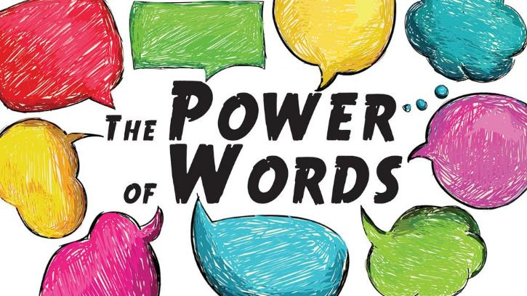
1. The transformative power of ‘fluid’ language 1.1. Introduction
On average, a person uses about 15,000 words per day, although the number can vary significantly depending on social and work context, personality and other factors. This figure was derived from a study conducted in 2007 by researchers Matthias Mehl, Simine Vazire, Nairán Ramírez-Esparza, Richard Slatcher and James Pennebaker, published in the Journal of Personality and Social Psychology.
Language directly impacts how we think and perceive the world, influencing both conscious and unconscious biases. Studies in social psychology reveal that language doesn't merely describe reality—it also shapes it, guiding the way we understand social roles, relationships and identities.
Source image:LinkedIn

Slide 5
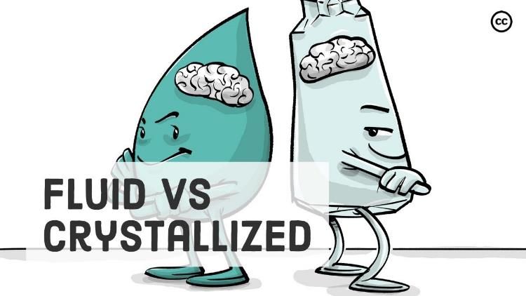
1. The transformative power of ‘fluid’ language
1.2 What does the adjective ‘fluid’ applied to language mean? (!)
Words carry a significant impact. Whether spoken or written, our communication affects not only the sender and recipient but also those who observe from the sidelines. The language we choose reveals our thinking, influences others, and can subtly reinforce gendered assumptions. In this sense, language reflects societal attitudes and underlying biases. Crucially, communication is not static—it evolves constantly, shaping both personal and professional realms and influencing broader societal concepts, such as gender equality. The concept of fluidity in languages highlights their dynamic and adaptable nature, reflecting the changes in society, culture, and individual identity.
Source image:Fluid and Crystallized Intelligence, Youtube channel

Slide 6
1. The transformative power of ‘fluid’ language 1.2 What does the adjective ‘fluid’ applied to language mean? (2)
When applied to languages, the term “fluid” can refer to several concepts:
Fluidity in language also encompasses creative expression, where speakers or writers play with language to convey meaning in innovative ways. This might include using metaphor, slang, or blending languages to express contemporary ideas and identities.
Languages can exhibit fluidity in their grammar and usage. For instance, as societal norms change, the way language is used to express gender may also change. This includes the adoption of gender-neutral terms or pronouns, which reflects a more fluid understanding of gender identity.
For instance, the use of 'they ’ as a neuter singular pronoun has become common to refer to people who do not identify exclusively as male or female. This change in grammar not only makes language more inclusive, but also recognises the reality of non-binary gender identities.

Slide 7
1. The transformative power of ‘fluid’ language
1.3 Redefining gender: insights into identity and expression (1)
In the context of gender identity, fluidity implies that people can identify in ways that are not limited to the traditional binaries of male and female. Some people may identify as non-binary, genderqueer or gender fluid, meaning that their gender experience may vary over time or according to context. This expanded understanding of gender identity has led to greater acceptance of different gender experiences, challenging historical conventions and social expectations.
Let's clarify some key definitions:
Biological Sex Identity: This refers to the physical and biological characteristics of an individual, including chromosomes (XX or XY), gonads (testes or ovaries) and primary and secondary sexual traits (such as breasts or body hair). For example, a person born with male physical characteristics (XY) is identified as male, while a person with female physical characteristics (XX) is identified as female.
Gender Identity: It is the internal and personal experience of being male, female, a combination of both, or neither. It is not necessarily related to biological sex and may differ from it. For example, a person assigned as male at birth may identify as female.
Gender Expression: Represents how a person expresses their gender through behaviour, clothing and hairstyle. For example, a person with a female gender identity may choose to dress in a traditionally feminine manner, but may also opt for a more androgynous or masculine style.

Slide 8
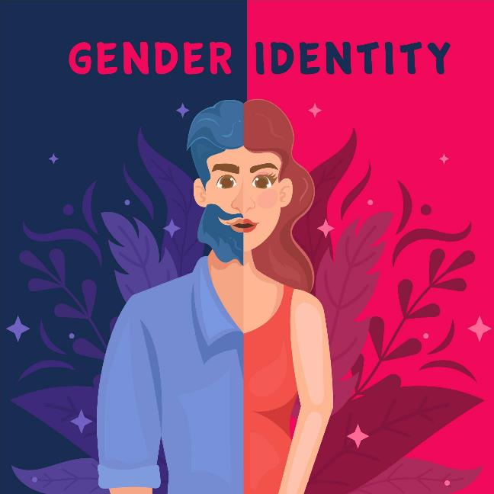
1. The transformative power of ‘fluid’ language
1.3 Redefining gender: insights into identity and expression (2)
Sexual Orientation: This refers to who a person is attracted to romantically or sexually. This concept is distinct from gender identity. For example, a woman may be attracted to men (heterosexual), to other women (homosexual) or to both (bisexual).
Non-Binary Gender Identity: Non-binary people do not identify exclusively as male or female. They may feel as a combination of both, as neither, or as a gender that fluctuates over time. For example, a non-binary person might use pronouns such as ‘they’ instead of ‘he’ or ‘she’.
Fluid Gender Identity: This is an identity that changes over time. A person with a fluid gender identity may identify as male at one time, female at another, or neither at another time. For example, someone might feel more masculine some days and more feminine on others.
**It is essential to remember that we must not take anything for granted about the person in front of us, as each individual has their own unique experience and identity.
Source image:Freepick

Slide 9
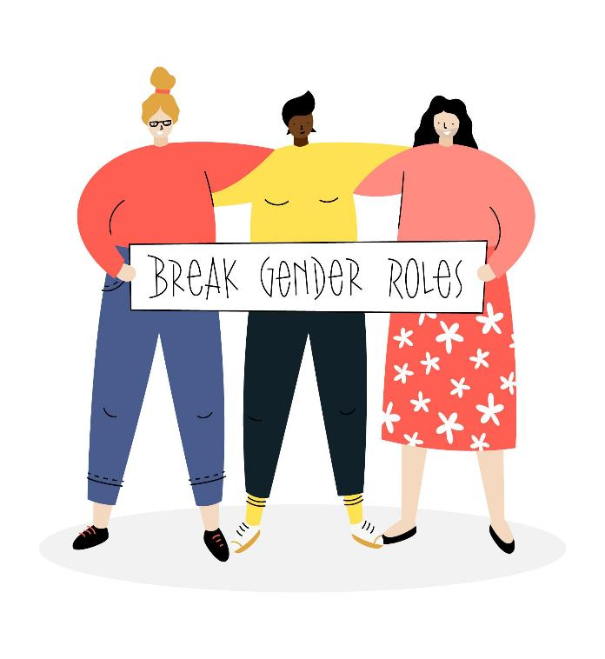
1. The transformative power of ‘fluid’ language
1.4. Words as tools for inclusion: addressing bias through language (1)
Using respectful and gender-sensitive language is key to creating an inclusive and welcoming environment. This is not only about gender, but also about awareness of biases, i.e. unconscious prejudices or inclinations that influence the way we think and act towards others. Biases can manifest themselves in many forms, leading to hasty judgements based on stereotypes of gender, race, sexual orientation and other characteristics.
In everyday communication, we often fall into these stereotypes, using expressions or assumptions that can be offensive or exclusionary. For example, automatically referring to a group of people with masculine terms or assuming someone's gender based on their appearance can reinforce preconceived ideas and contribute to an environment of exclusion. More inclusive language not only recognises and respects the diversity of identities, but also challenges these biases, promoting more authentic and respectful communication. Adopting gender-sensitive language is an important step towards building more meaningful relationships and eliminating stereotypes, contributing to a more equal and inclusive society.
Source image:Freepick

Slide 10
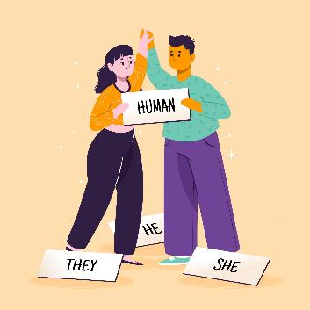
1. The transformative power of ‘fluid’ language
1.4. Words as tools for inclusion: addressing bias through language (2)
1.4.2. Expressions of Value and Gender Stereotypes
1.4.1 Examples of Expressions with Colour-Signified Stereotypes
Saying ‘it's black as night’ or ‘seeing black’ tends to associate the colour black with something negative or dark, while ‘seeing everything pink’ suggests a positive and optimistic outlook. These expressions, although often unconscious, associate black with pessimism and danger, while other colours have more neutral or positive meanings.
Alternative:It is possible to say ‘it's dark as night’ or simply ‘seeing negatively’, avoiding direct and stereotypical associations with colours.
Phrases such as ‘reacted like a man’ or ‘spoke like a woman’ reinforce the idea that certain behaviours are intrinsically linked to gender.
Alternative: Use phrases such as ‘reacted with courage’ or ‘spoke with sensitivity’, which avoid linking the behaviour to a gender, giving space for individuality without stereotyping.
Source image:Freepick

Slide 11
1. The transformative power of ‘fluid’ language 1.4. Words as tools for inclusion: addressing bias through language (3)
1.4.3. Gender Exclusivity in Professions Historically Associated with Only One Gender
In many languages, gendered language can create implicit associations between certain professions and a specific gender. For example, phrases like “the policeman intervened promptly” or “the teacher [female] has been teaching for years” may suggest that these roles are inherently tied to one gender, reinforcing stereotypes about who belongs in these positions.
In contrast, using gender-neutral alternatives such as “the police officer intervened” or “the teacher has been teaching for years” helps to eliminate this exclusivity.
While English has many gender-neutral terms, other languages may require more conscious effort to use inclusive language. This shift towards neutral job titles supports inclusivity and challenges traditional gender expectations associated with various professions.
1.4.4. Patronising language
One example of patronising language is the additions of diminutive suffixes to denote that the referent is female.
Example: The usherette helped me to my seat just as the actress came on stage.
Alternative: The usher helped me to my seat just as the actor came on stage.
Think about the meaning of the words kitchenette and novelette compared to the words kitchen and novel to see the effect of the –ette suffix.

Slide 12
2.Recognize and use strategies to avoid gender stereotypes in language
2.1. Key Concepts of Inclusive Language (1)
The fluidity of language plays a crucial role in reflecting and supporting the diversity of human experience. Just as gender identity can exist beyond the traditional binaries of male and female, language itself is evolving to capture a wider spectrum of identities. This shift is significant, as language not only describes our reality but also shapes it—helping people feel seen, respected, and validated.
2.1.1 Use of they as singular pronoun
One of the most notable innovations in gender-sensitive language is the use of gender-neutral pronouns, such as "they/them" in English. Though "they" has historically been used as a plural pronoun, its adoption as a singular, gender-neutral option has become widespread and accepted, even being added to dictionaries and style guides.
For those who identify outside the binary, using "they" offers a respectful, inclusive way to refer to individuals without presuming gender. This has also spurred the creation of other pronouns, such as "ze/hir," which aim to provide additional inclusive options for people who may feel that "they" doesn’t fully capture their gender experience.
Example:
"Taylor is bringing their friend with them, and they will arrive at 6."
In this sentence, "they" and "their" refer to Taylor and their friend, respecting Taylor's unspecified gender.

Slide 13
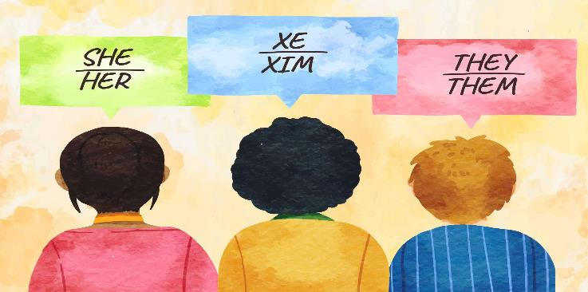
2.Recognize and use strategies to avoid gender stereotypes in language
2.1. Key Concepts of Inclusive Language (2)
2.1.2. Neologisms and neutral terms
2.1.3. Use of Mx.
In professional or formal settings, terms like "chairperson" instead of "chairman" or "spokesperson" instead of "spokesman" are now commonly used, as are gender-neutral alternatives for traditionally gendered family terms, like "sibling" instead of "brother" or "sister." This shift is increasingly common in official documents, academia, and media, where institutions are revising guidelines to make language more reflective of diverse gender identities.
The use of Mx. as a title (rather than Mr. or Ms.) is another example of how language is accommodating non-binary and genderqueer identities. As an honorific, Mx. is now recognized by many organizations and some governments, providing a formal option that respects gender diversity.
Source image:Freepick

Slide 14
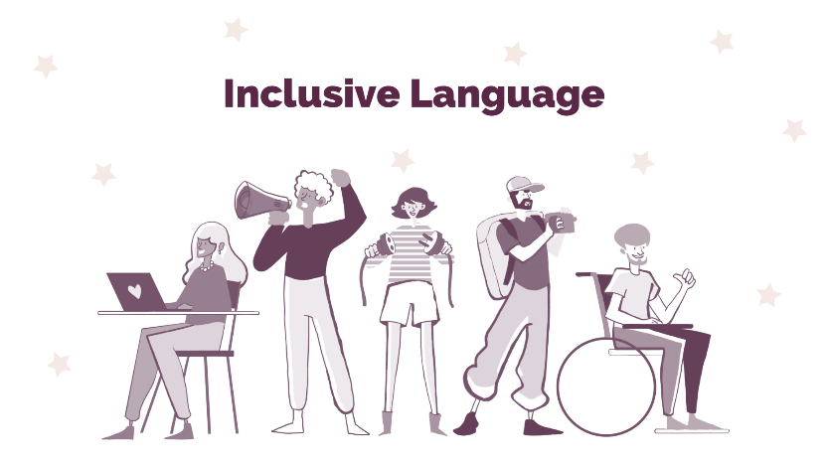
2.Recognize and use strategies to avoid gender stereotypes in language
2.1. Key Concepts of Inclusive Language (3)
2.1.4. Use of 'x', '@', and '-' forms for non-binary expression
In languages where grammatical gender is embedded (such as French, Italian and Spanish), inclusive adaptations have also emerged. For example, the use of gender-neutral endings is gaining traction—such as "x" or "@" in place of traditional masculine and feminine endings ("Latinx" in place of "Latino" or "Latina"), or the Italian "-u" and "-," as in "tutt" to mean "everyone." These linguistic changes help reduce the dominance of masculine forms as default and provide options for non-binary individuals who may not feel comfortable with binary endings.
However, while this adaptations promote inclusivity, they can make sentences slightly harder to read or pronounce, especially for those unfamiliar with these forms. In some cases, the visual flow of the text can be interrupted by unfamiliar symbols or endings, which challenges traditional reading patterns.
Source image:https://blog.amara.org/inclusive-language/

Slide 15
2. Recognize and use strategies to avoid gender stereotypes in language
2.2. Strategies for Gender-Inclusive Communication (1)
Gender stereotyping in language often arises from using terms, expressions, or structures that reinforce outdated gender roles or assumptions and making changes in this area can have a significant positive impact on social perceptions and individual inclusivity.
2.2.1. Plural forms
2.2.2. Omitting pronouns
Using plural forms offers an easy, gender-neutral alternative to gendered pronouns. This approach is preferable because it is inclusive and helps avoid complex sentence structures.
Instead of "Each actor should memorize his lines"
Use
"All actors should memorize their lines"
Instead of
"Every waiter must wear his uniform"
Use
“All waiters must wear their uniforms"
Often, a sentence can be rephrased to avoid the need for gendered pronouns. However, depending on the context, this approach may feel a bit impersonal and should be applied thoughtfully.
Instead of
Employees should submit timesheets by Friday*
Use
"A timesheet must be submitted by Friday for payroll processing."
*In various languages, it's common to use the masculine form as a generic term to refer to all individuals.

Slide 16
2. Recognize and use strategies to avoid gender stereotypes in language
2.2. Strategies for Gender-Inclusive Communication (2)
2.2.3. Multiple pronouns/forms
2.2.4. Passive voice
This technique explicitly incorporates both feminine and masculine forms to avoid the use of the generic masculine. However, it should be applied sparingly, as excessive repetition can impact the text's readability. If you choose to combine pronouns, it is imperative that a standardized version be used consistently throughout the document (e.g. her/his versus her or his).
Instead of "Each actor should memorize his lines"
Use
"All actors should memorize their lines"
Instead of
"Every waiter must wear his uniform"
Use
“All waiters must wear their uniforms"
Using the passive voice is another alternative to the generic masculine. However, it’s important to note that the passive voice can make the text feel less dynamic. Nevertheless, this approach may be more suitable for certain documents.
Instead of
"The manager should ensure that his team submits the report by the deadline."
Use
"The report should be submitted by the deadline."
*In various languages, it's common to use the masculine form as a generic term to refer to all individuals.

Slide 17
2. Recognize and use strategies to avoid gender stereotypes in language
2.3. Avoiding Gender Stereotypes in Language
Rephrasing sentences can greatly diminish gender bias. Instead of saying, "He is a strong leader," a more inclusive approach would be to say, "They demonstrate strong leadership skills." This not only avoids assumptions about gender but also normalizes the use of singular "they," which has gained traction as a gender-neutral pronoun.
In job descriptions, it's essential to steer clear of masculine-coded language that might deter female candidates or those who identify outside the gender binary. Words like "aggressive" or "dominant" can perpetuate stereotypes about masculinity, while terms like "collaborative" or "inclusive" appeal to a broader audience.
Furthermore, adapting how we address groups can promote inclusivity. Instead of "ladies and gentlemen," one could opt for "everyone" or "distinguished guests," ensuring no one feels excluded. These linguistic adjustments not only enhance communication but also reflect a commitment to diversity and equality in all spheres of life

Slide 18
2. Recognize and use strategies to avoid gender stereotypes in language
2.4. Examples of texts that have been rewritten using inclusive language
Original text
More inclusive text
Precarious employment is man’s greatest challenge in the modern age. This development is wreaking havoc on workers from all occupations – from builders and policemen through to teachers and even waitresses.
On 1 November 2000, Judith Smith, the spokeswoman for the minister stated: “Ladies and gentlemen, the failures of the last government have left many families struggling.
Our social inclusion strategy embodies the virile action needed to overcome the spectre of precarious employment and give everyone a decent chance in life.”
Precarious employment is humanity’s greatest challenge in the modern age. This development is wreaking havoc on workers from all occupations – from builders and police officers through to teachers and even waiting staff.
On 1 November 2000, Judith Smith the spokesperson for the minister stated: “Dear colleagues, the failures of the last government have left many families struggling.
Our social inclusion strategy embodies the strong action needed to overcome the spectre of precarious employment and give everyone a decent chance in life.
Source: Guidelines for the use of language as a driver of inclusivity, Council d’Europe, 2024, pg.8-9

Slide 19
2. Recognize and use strategies to avoid gender stereotypes in language
2.4. Examples of texts that have been rewritten using inclusive language
Original text
More inclusive text
The committee is looking for a new Chairman to take the helm and provide strategic vision. He will be expected to participate actively in defining the organisational priorities of the coming year, drawing from his extensive business insights and quickly mastering all the necessary details of the committee’s functioning.
Diversity is important to us as an organisation. Everyone who meets the assessment criteria in the Application Pack is encouraged to apply for this position.
The committee is looking for a new Chair to take the helm and provide strategic vision. She or he will be expected to participate actively in defining the organisational priorities of the coming year, drawing from his or her extensive business insights and quickly getting to grips with all the necessary details of the committee’s functioning.
Diversity is important to us as an organisation. Everyone who meets the assessment criteria in the Application Pack is encouraged to apply for this position. Applications from women, who are currently underrepresented, are particularly welcome.
Source: Guidelines for the use of language as a driver of inclusivity, Council d’Europe, 2024, pg.8-9

Slide 20
3. Language activists on social media influence how we communicate (1)
3.1. Linguistic advocates on LinkedIn
Language activists on social media promote inclusive language, seeking to change language norms to avoid discriminatory or exclusive expressions, such as those based on gender or disability.
3.1.1 Alice Orrú
A freelance and multilingual content designer and UX writer advocating for inclusive and accessible languages.
Additionally, she co-authored the first italian handbook on inclusive and accessible writing “Scrivi e lascia vivere” (‘’Write and let others live”) and her professional newsletter “Ojalá” address the issue of inclusive and accessible communication in the digital environment
3.1.2. Charlotte Marti
An inclusive French Translator and Communication Expert at creating bias-free communication in French though translation from English and German. She is the cofounder of (R)évolution Inclusive is a collective of 12 freelance professional translators working from different languages into gender-inclusive French.

Slide 21
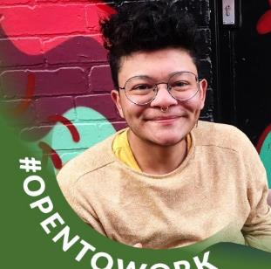
3. Language activists on social media influence how we communicate (2)
3.1. Linguistic advocates on LinkedIn
3.1.4. Mariana Dadalto Schettino
A translator specialized in D&I, using ‘Gender Inclusive Language’ for Localization in the Gaming Industry. Here an interesting interview where she says: “Making use of gender inclusive language leads to better communication with the female players and generates high quality localized products that actively avoid leaving any group of customers as an outsider”.
3.1.3 Ari Vélez Olivera (they/them)
An editor and proofreader who specializes in translating from English to Spanish using non-binary and inclusive language.

Slide 22
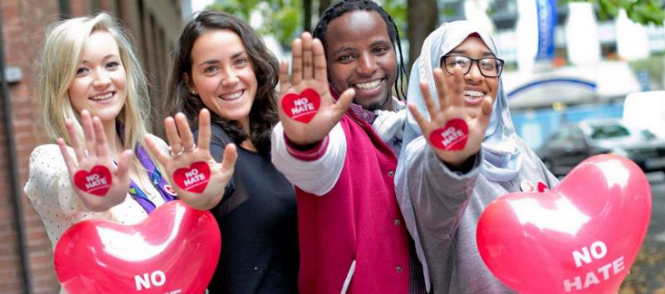
3. Language activists on social media influence how we communicate
3.2. EU Campaigns Promoting Respectful Communication
Through campaigns, hashtags, and educational content, these activists highlight issues related to gender, race, and identity, prompting discussions that were once considered taboo.
In this context, initiatives from the European Union (EU) have further amplified these efforts. Campaigns such as "No Hate Speech Movement" and "EU Gender Equality Strategy" promote respectful language and combat discrimination across member states. These campaigns emphasize the importance of using inclusive language to foster understanding and acceptance among diverse communities. They provide resources and guidelines for individuals and organizations to adopt language that respects gender identity and cultural differences.
The European Commission launched a campaign to challenge gender stereotypes, on 8 March 2023. The #EndGenderStereotypes campaign, disseminated throughout 2023, tackled gender stereotypes affecting both men and women in different spheres of life, including career choices, sharing care responsibilities and decision-making.

Slide 23
Self-assessment test
Question 1. What is a bias?
Bias is a tendency to favor one perspective or outcome over others, often leading to unfair judgments or conclusions.
B) Bias refers to a random error that occurs by chance, affecting the reliability of data or conclusions.
C) Bias is the capacity to make decisions solely based on objective facts, without any influence from personal feelings or opinions.

Slide 24
Self-assessment test
Question 1. What is a bias?
Correct option: [a, Bias is a tendency to favor one perspective or outcome over others, often leading to unfair judgments or conclusions]

Slide 25
Self-assessment test
Question 2. What role does language play in communication according to the module?
a)Language only affects the sender and recipient without impacting broader societal concepts.
b) language is a fixed tool that does not change over time and has no effect on societal attitudes.
c) Language reveals our thinking, influences others, and reflects societal attitudes and biases.

Slide 26
Self-assessment test
Question 2. What role does language play in communication according to the module?
Correct option: [c, language reveals our thinking, influences others, and reflects societal attitudes and biases.]

Slide 27
Self-assessment test
Question 3. How can gender identity differ from biological sex?
O b) Gender identity is an internal experience that may not align with the biological seassigned at birth.
c) Gender identity is fixed and does not change over time.
Gender identity is solely determined by chromosomes.

Slide 28
Self-assessment test
Question 3. How can gender identity differ from biological sex?
Correct option: [b, Gender identity is an internal experience that may not align with the biological seassigned at birth.]

Slide 29
Self-assessment test
Question 4. How would you make these words more inclusive in terms of gender-neutral language? Chairman/ Mankind/ Ladies and Gentlemen
a)Chair/ humankind/Dear participants
b) Chair/Womenkind/Gentlemen and Ladies
c) chair/ humankind/ ladies

Slide 30
Self-assessment test
Question 4. Stereotypes in languages. Which one is correct?
Correct option: [a, Chair/ humankind/Dear participants]

Slide 31
Self-assessment test
Question 5. What is the purpose of using adaptations such as the Italian "-u" and "-," in words like "tutt"?
a) To emphasize masculine forms
b) To mean "everyone" in a gender-neutral way
c) To create more complex grammatical structures

Slide 32
Self-assessment test
Question 5. What is the purpose of using adaptations such as the Italian "-u" and "-," in words like "tutt"?
Correct option: [b, to mean "everyone" in a gender-neutral way]

Slide 33
Summing up
Language is fluid. Inclusive language is always changing as people find new expressions and words to describe themselves.
It is not all about gender.
Language activists on social media promote inclusive language, seeking to change language norms to avoid discriminatory or exclusive expressions, such as those based on gender or disability.
Often unintentionally, our language invokes gendered notions of expectations and roles for women and men, challenging the achievement of gender equality. It is our responsibility to dissect bias from our diction and carry on inclusively in our personal and professional lives.

Slide 34
Thanks for your attention!
Explore more resources at www.allin-inclusion.eu

