Slide 1
Accessibility in Digital Communication
Developed by IT Solutions for All

Slide 2
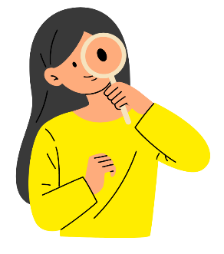
Index
Unit 1. Principles of Web Accessibility
Unit 2. Assistive Tools and Adaptive Technologies
Unit 3. Inclusive Web Design

Slide 3
Learning outcomes
In this module, you will learn:
How to understand and apply the principles of web accessibility to create inclusive digital content.
The use of assistive tools and adaptive technologies to enhance accessibility for diverse users.
Inclusive web design techniques and best practices to ensure web content is accessible and usable by everyone.

Slide 4
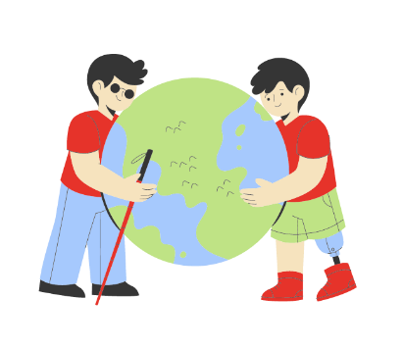
1. Principles of Web Accessibility 1.1. Understanding Accessibility
According to the Pan-Hispanic dictionary of legal Spanish, universal accessibility is “the condition that environments, processes, goods, products and services, as well as objects, instruments, tools and devices, must meet in order to be understandable, usable and practicable by all people in conditions of safety and comfort and in the most autonomous and natural way possible”.

Slide 5
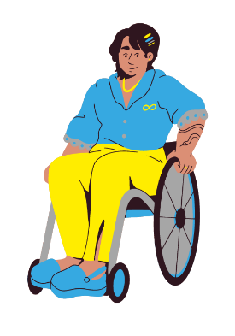
1. Principles of Web Accessibility 1.1. Understanding Accessibility
Universal accessibility includes 3 types of accessibility:
Cognitive accessibility: a characteristic that makes something easy to understand and communicate.
Physical accessibility: characteristic that indicates that something can be used easily, or that a space can be accessed easily, without relying on physical limitations.
Sensory accessibility: characteristic that indicates that something can be used easily, or that a space can be accessed easily, without relying on sensory limitations.

Slide 6
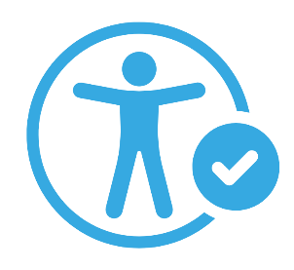
1. Principles of Web Accessibility 1.1. Understanding Accessibility
Examples:
Cognitive accessibility: be able to understand a text because it is written in a simpler wording, be able to understand a legal article because it is adapted to an easier reading style.
Physical accessibility: to be able to enter a building with a wheelchair, to be able to open a door even if you have little strength.
Sensory accessibility: being able to understand a video because it has captions or sign language, being able to read a document because it has large print or is written in braille.

Slide 7
1. Principles of Web Accessibility 1.1. Understanding Accessibility
Knowing this, when we talk about web accessibility, we can understand it as the fact that web pages are usable by the largest possible number of people, regardless of their knowledge or personal skills, as well as the technical characteristics of their devices.
In the 21st century, web accessibility is fundamental to many aspects of life, such as education, employment, government, commerce, healthcare and entertainment. Providing equitable access and equal opportunities for all people is of vital importance.

Slide 8
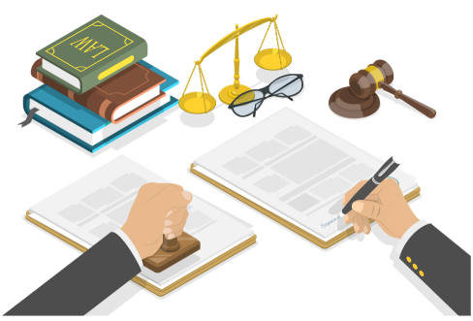
1. Principles of Web Accessibility 1.2. Legal Framework and Standards
In the European Union, digital accessibility is legislated through Directive (EU) 2016/2102 on the accessibility of websites and mobile applications of public sector bodies, referred to as WAD for Web Accessibility Directive. This directive obliges all public sector bodies in the EU to make their websites and mobile applications accessible.
To achieve this, the European Union, together with the main European standardization organizations, developed a standard called EN 301 549, which establishes accessibility requirements for ICT products and services. These standards are largely based on the Web Content Accessibility Guidelines (WCAG).

Slide 9
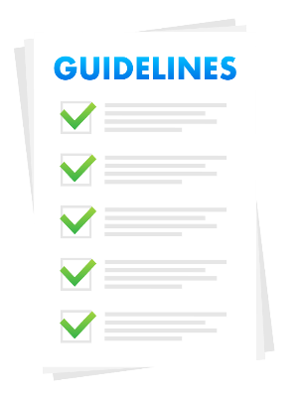
1. Principles of Web Accessibility 1.3. Web Content Accessibility Guidelines (WCAG)
The Web Content Accessibility Guidelines (WCAG) provide a single, shared standard that meets the needs of individuals, organizations and governments internationally for accessible web content.
Developed by the World Wide Web Consortium (W3C), they are intended for developers and creators of Web content and Web accessibility evaluation tools.

Slide 10
1. Principles of Web Accessibility 1.3. Web Content Accessibility Guidelines (WCAG)
The most up-to-date version is WCAG 2.2, which includes 13 guidelines and, like the previous versions, includes four fundamental principles:
Perceivable: users must be able to perceive the information presented (it cannot be invisible to all their senses).
Operable: users must be able to operate the interface (the interface cannot require an interaction that a user cannot perform).
Understandable: users must be able to understand both the information and the operation of the user interface (the content or operation cannot be out of their reach).
Robust: users must be able to access content as technologies advance (as technologies and user agents evolve, content must remain accessible).

Slide 11
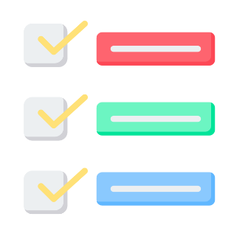
1. Principles of Web Accessibility 1.3. Web Content Accessibility Guidelines (WCAG)
Compliance with the WCAG guidelines is evaluated through compliance criteria, classified as follows:
Level A: minimum accessibility requirements.
Level AA: elimination of major accessibility barriers.
Level AAA: the highest and most stringent level of accessibility.
Each level implies compliance with the previous levels. In Spain, it is mandatory for Public Administrations to comply with level AA as a minimum.

Slide 12
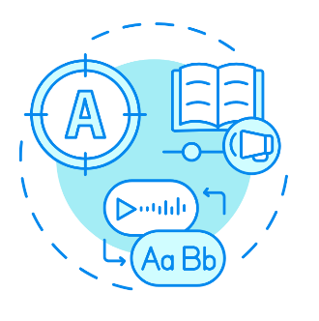
2. Assistive Tools and Adaptive Technologies 2.1. Overview of Assistive Tools
Assistive Technologies (AT) applied to web accessibility are those that provide technical assistance to people with difficulties in using the web and digital devices, interacting with interfaces or accessing content.
These technologies may include tools of different typologies, designed to meet a wide range of needs. In this case, we will focus on accessibility software tools such as those described below.

Slide 13
2. Assistive Tools and Adaptive Technologies 2.1. Overview of Assistive Tools
Screen readers
Screen magnifiers
Software used by visually impaired people to read screen content. A voice synthesizer reads and explains what appears on the screen. Examples:
NonVisual Desktop Access (NVDA): free, portable, open source screen reader developed by Microsoft. Supports 54 languages and numerous applications.
Job Access With Speech (JAWS): widely used screen reader in Windows offering numerous features and customization.
VoiceOver: integrated screen reader for macOS and iOS devices, offering robust compatibility and integration with Apple products.
Magnifiers or screen magnifiers enlarge text and/or images and graphics on the computer screen, making them easier to see. Examples:
ZoomText: fully integrated magnification and reading tool adapted for users with low vision. Offers customizable magnification levels and color enhancements.
MAGic: provides magnification and screen reading, designed for users with low vision. Maintains letter sharpness even at high magnification levels.

Slide 14
2. Assistive Tools and Adaptive Technologies 2.1. Overview of Assistive Tools
Speech recognition software
These tools allow users to control devices and enter text using voice commands. They support people with mobility problems or difficulties using peripherals. Examples:
Dragon: powerful and accurate speech recognition software for Windows, developed by Nuance.
Apple Dictation: integrated speech recognition tool for iOS and macOS users.
Gboard: the Google keyboard, available for both Android and iOS phones. It features voice recognition and allows you to search the Internet and even translate text.
Otter: collaborative tool and meeting assistant that allows to transcribe the text of a conversation, among other functionalities.
Windows Speech Recognition: integrated function in Windows that allows voice control and voice dictation.

Slide 15
2. Assistive Tools and Adaptive Technologies 2.2. Adaptive Technologies
Adaptive technologies are those that help people with functional disabilities to make use of computers and their peripherals despite the difficulties they may have with their abilities.
From alternative input devices to adapted keyboards and mice, and even alternative video game controllers, there is a wide variety of technologies adapted to the various abilities of individuals.
Accompanied by the aforementioned assistive tools, these technologies can mean a before and after in the experience of many people during the use of digital devices, and it is important to make them known to promote accessibility in different contexts. Here are some examples.
Mouse alternatives
Joystick: similar in appearance to a console controller, provides an alternative method of control in which the joystick determines the direction and speed of the pointer.
Mouth mouse: allows you to control the cursor with mouth movements, such as puffs or aspirations.
Mouse with sensors: allows to make use with the movement of the head.
Foot mouse: pushbuttons operated by foot movement and foot pressure.

Slide 16
2. Assistive Tools and Adaptive Technologies 2.2. Adaptive Technologies
Adapted keyboards
Switches
Large type keyboards: larger letters and high-contrast colors for people with low vision. Some even include larger keys.
Ergonomic keyboards: designed to reduce strain and provide a more comfortable typing experience. Some are designed to be used with one hand.
Adaptive keyboard cover: a rigid cover that is placed over the keyboard and forms a barrier to prevent unwanted keystrokes, useful for people with motor disabilities or poor dexterity.
Braille keyboards: designed for Braille writing.
Devices that replace traditional keyboard and mouse functions, allowing users to control computers with simple keystrokes.
Eye tracking devices
Webcams and/or software with eye-tracking technology that allows users to control their computer and interact with digital content by eye movement, suitable for people with limited or no hand movement.

Slide 17
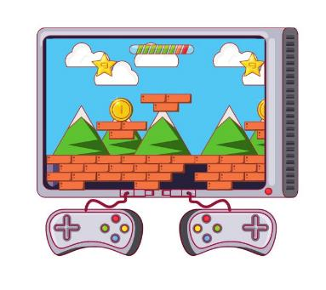
2. Assistive Tools and Adaptive Technologies 2.2. Adaptive Technologies
Videogames
Today, adapted technologies are not only limited to the use of computers, but devices are also being developed so that people with disabilities can enjoy activities such as video games, eliminating barriers in leisure time as well.
Major brands in the video game industry, such as PlayStation and Xbox, already have accessible controllers that contribute to the physical accessibility of video games.

Slide 18
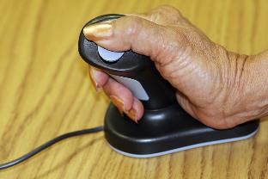
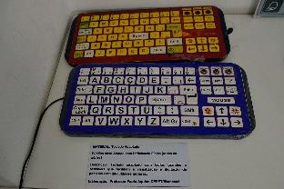
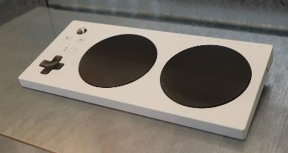
2. Assistive Tools and Adaptive Technologies 2.2. Adaptive Technologies
Adapted mouse
Adapted keyboard
Accessible video game controller
Image from cobalt123, Flickr
Image from Tomaz Silva, Agência Brasil
Image from Geni, Wikimedia Commons

Slide 19
2. Assistive Tools and Adaptive Technologies 2.3. Emerging Technologies
New emerging technologies play an important role in the field of accessibility, as they enable advances that improve the lives of people with disabilities at levels that have not yet been fully explored.
Artificial Intelligence, Machine Learning or Augmented Reality are just some of the technologies of the future that are being successfully integrated into accessibility.
AI and Machine Learning
AI-based screen readers: Improving the accuracy and context awareness of screen readers through Artificial Intelligence. Some screen readers that already integrate this technology are Typeahead AI or accessiBe.
Automatic captioning and transcription: AI-based tools to generate subtitles and transcripts in real time or for pre-recorded content. Platforms such as YouTube already integrate this technology, video editors such as Clipchamp, and dedicated tools such as happyscribe.

Slide 20
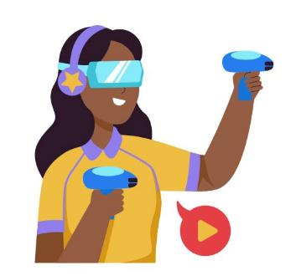
2. Assistive Tools and Adaptive Technologies 2.3. Emerging Technologies
Virtual and Augmented Reality
VR for training that addresses disability: the use of VR simulators can be used to train people on how to interact with people with disabilities and create accessible environments. Similarly, people with disabilities can be trained in controlled environments to help them deal with real-life situations.
AR for real-time assistance: Augmented Reality applications can provide real-time data and assistance, helping experts make informed decisions or contribute to remote assistance, improving safety and efficiency.

Slide 21
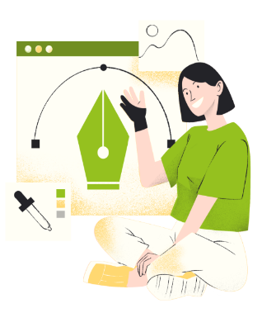
3. Inclusive Web Design 3.1. Principles of Universal Design
When we talk about universal web design, we refer to an approach to user experience (UX) in which websites and web applications should be accessible and usable by as many people as possible, regardless of their abilities, disabilities or circumstances. Inclusive web design principles and practices should aim to ensure that a wide variety of users can access, understand and interact with content.
The 7 Principles of Universal Design were developed in 1997 by a group of architects, designers, engineers and researchers at North Carolina State University.

Slide 22
3. Inclusive Web Design 3.1. Principles of Universal Design
Equitable use: the design is useful and marketable for people with diverse abilities.
Flexibility in Use: design accommodates a wide range of individual preferences and capabilities.
Simple and Intuitive: the use of the design is easy to understand, regardless of the user's experience, knowledge, language skills or level of concentration.
Perceptible Information: the design effectively communicates the necessary information to the user, regardless of environmental conditions or the user's sensory capabilities.
Tolerance for Error: design minimizes hazards and adverse consequences of accidental or unintended actions.
Low Physical Effort: the design can be used efficiently and comfortably with a minimum of fatigue.
Size and Space for Approach and Use: adequate size and space is provided for approach, reach, manipulation and use, regardless of body size, posture or mobility of the user.

Slide 23
3. Inclusive Web Design 3.2. Design Techniques and Practices
Color contrast
Text readability
Make sure that text and other critical elements are distinguishable from the background for visually impaired users. There are tools to check the contrast ratio between background color and text, such as WebAIM or AccessibleWeb.
According to WCAG level AA, the contrast ratio should be at least 4.5:1 for normal text and 3:1 for large text.
For level AAA, the contrast ratio should be at least 7:1 for normal text and 4.5:1 for large text.
Use clear and legible fonts. For example, sans serif fonts such as Arial or Verdana are a good choice.
Make sure the size is large enough for comfortable reading, and maintain proper line spacing.
Do not place text over images or motifs that reduce readability.

Slide 24
3. Inclusive Web Design 3.2. Design Techniques and Practices
Multimedia accessibility
Design adaptable to different devices
Ensure that audio and video content is accessible to users with hearing, visual and cognitive impairments.
Provide captions, transcripts and audio descriptions on multimedia content.
Images should also have alternative descriptions.
Make sure websites and other design elements are accessible and usable on a wide range of devices, from computers to smartphones.
First, make sure content and functionalities are accessible on small screens, and then enhance them for larger screens.

Slide 25
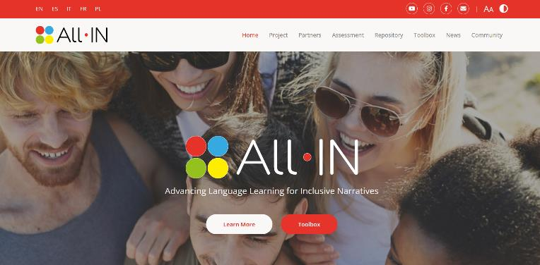
3. Inclusive Web Design 3.2. Design Techniques and Practices (good practices examples)
Accessibility features:
Text re-size
Color contrast

Slide 26
3. Inclusive Web Design 3.2. Design Techniques and Practices (good practices examples)

Slide 27
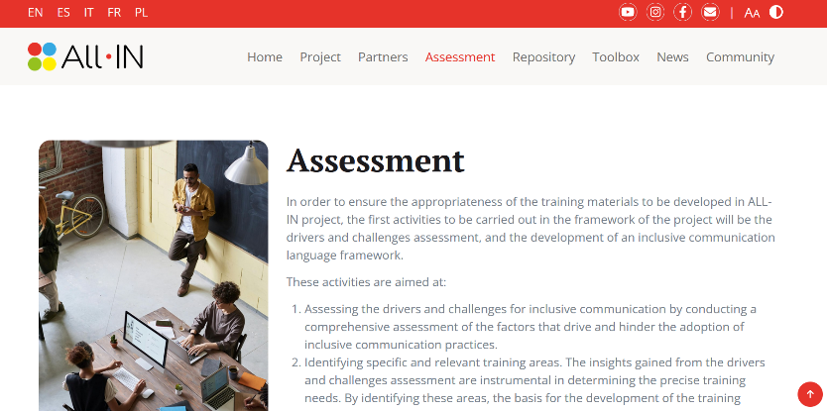
3. Inclusive Web Design 3.2. Design Techniques and Practices (good practices examples)

Slide 28
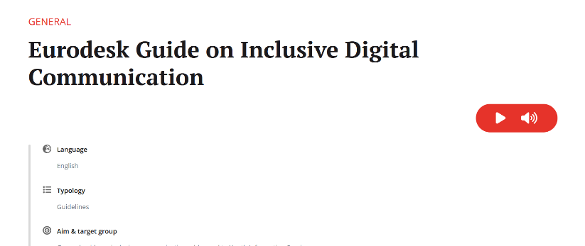
3. Inclusive Web Design 3.2. Design Techniques and Practices (good practices examples)
Accessibility feature:
Text-to-speech

Slide 29
3. Inclusive Web Design 3.3. Accessibility Testing and Evaluation
Finally, you should check the accessibility of the design. The most important thing is always human supervision: check that you comply with WCAG guidelines and universal design principles, get other people to use the site and collect their feedback. In addition, you can use automated tools to check web accessibility, such as:
WAVE (Web Accessibility Evaluation Tool): provides visual feedback on the accessibility of web content.
Axe DevTools: a browser extension that detects accessibility issues and suggests solutions.
Lighthouse: an open source tool from Google that audits web pages for performance, accessibility and best practice.

Slide 30
Self-assessment test
Question 1. Which of the following best describes the main goal of web accessibility?
Option a: Enhancing website aesthetics
Option b: Ensuring websites are usable by all people, including those with disabilities
Option c: Increasing website traffic
Option d: Reducing server load

Slide 31
Self-assessment test
Question 1. Which of the following best describes the main goal of web accessibility?
Correct option: b- Ensuring websites are usable by all people, including those with disabilities

Slide 32
Self-assessment test
Question 2. What is the purpose of the Web Content Accessibility Guidelines (WCAG)?
Option a: To provide aesthetic design principles for websites
Option b: To set technical standards for web performance
Option c: To offer guidelines for making web content more accessible to people with disabilities
Option d: To create marketing strategies for web content

Slide 33
Self-assessment test
Question 2. What is the purpose of the Web Content Accessibility Guidelines (WCAG)?
Correct option: c- To offer guidelines for making web content more accessible to people with disabilities

Slide 34
Self-assessment test
Question 3. Which of the following is an example of an assistive tool for web accessibility?
Option a: High-resolution display
Option b: Screen reader software
Option c: Video compression software
Option d: Image editing software

Slide 35
Self-assessment test
Question 3. Which of the following is an example of an assistive tool for web accessibility?
Correct option: b- Screen reader software

Slide 36
Self-assessment test
Question 4. Which principle of universal web design focuses on making the design adaptable to a wide range of individual preferences and capabilities?
Option a: Principle two: Flexibility in Use
Option b: Principle three: Simple and Intuitive
Option c: Principle four: Perceptible Information
Option d: Principle five: Tolerance for Error

Slide 37
Self-assessment test
Question 4. Which principle of universal web design focuses on making the design adaptable to a wide range of individual preferences and capabilities?
Correct option: a- Principle two: Flexibility in Use

Slide 38
Self-assessment test
Question 5. Which automated tool can be used for accessibility testing of web content?
Option a: Photoshop
Option b: Dreamweaver
Option c: WAVE
Option d: Excel

Slide 39
Self-assessment test
Question 5. Which automated tool can be used for accessibility testing of web content?
Correct option: c- WAVE

Slide 40
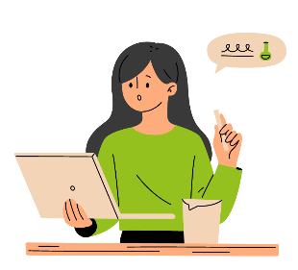
Summing up
Now you know what accessibility is and why it is essential for digital communication.
You have explored different assistive tools and adaptive technologies that help users with disabilities to access digital content.
You have learned what WCAG is, the principles of universal design, and how to measure the accessibility of a website.
You have gained practical skills to design and test web content to ensure that it meets accessibility standards.

Slide 41
Thanks for your attention!
Explore more resources at www.allin-inclusion.eu

