Slide 1
DIVERSITY AWARENESS
Developed by IHF

Slide 2
Index
Unit 1. UNDERSTANDING STEREOTYPES AND PREJUDICES
Section 1: Overview of what stereotypes and prejudices are
Section 2: Impact of Stereotypes and Prejudices
Section 3: Case Study
Unit 2. IMPACT OF DISCRIMINATION ON DIFFERENT GROUPS
Section 1: Understanding the Impact on Different Groups
Section 2: Terminology and its Effects
Section 3: Case Study
Unit 3. ENGAGING TARGET GROUPS EFFECTIVELY
Section 1: Fostering Empathy and Respect
Section 2: Active Listening Skills
Section 3: Applying Concepts in Real-Life Situations

Slide 3
Learning outcomes
In this module, you will learn:
How to gain insight into the origins and impacts of stereotypes and prejudices, and how they shape societal interactions.
How to understand the impact of stereotypes and prejudices on different social groups, and how the barrier between perceived differences is reinforced by the use of language and terminology.
How to develop skills to promote empathy, respect, and active listening, and apply these principles to overcome prejudices and foster inclusive environments.

Slide 4
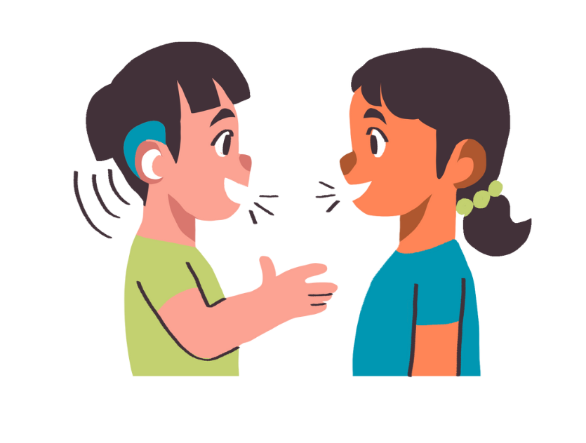
Unit 1
UNDERSTANDING STEREOTYPES AND PREJUDICES

Slide 5
1. UNDERSTANDING STEREOTYPES AND PREJUDICES Section 1: Overview of what stereotypes and prejudices are
Stereotypes and prejudices are ideas we hold about events, groups, generations, nationalities and characteristics of certain individuals that can lead us to adopt negative attitudes towards them.
STEREOTYPE
The term originally referred to a rigid, reusable papier-mâché mold used in typography. By the early 1900s, it evolved in social psychology to describe rigid mental images or "cognitive molds" we use to represent reality.
PREJUDICE
It can be seen as an evolution of the stereotype, because it represents a «pre-judgment», that is a negative judgment that precedes our direct experience.

Slide 6
1. UNDERSTANDING STEREOTYPES AND PREJUDICES Section 1: Overview of what stereotypes and prejudices are
For Gordon Allport (an American psychologist), stereotypes are learned in childhood.
Two ways of learning:
Adopting the prejudice of parents/family members
Growing up in an environment that makes children suspicious or fearful
Prejudices and stereotypes are not random. They stem from a social group's cultural background, passed down, crystallized and learned through socialization.

Slide 7
1. UNDERSTANDING STEREOTYPES AND PREJUDICES Section 2: Impact of stereotypes and prejudices
Stereotype can be considered as a hypothesis (cognitive component), prejudice as a belief (evaluative component) and both can lead to discrimination, which is an action (behavioural component).
The stereotype forms the basis of prejudice.
The cognitive factor is related to the stereotype, then there is an evaluative factor from which prejudice arises.
Prejudice is linked to a more affective aspect
When I assess the feelings that follow prejudice, a behavioural factor ensues, through which I discriminate. Indeed, this can lead to discrimination.
Discrimination is thus a behavioural component
This is because it leads to a change in the way of acting

Slide 8
1. UNDERSTANDING STEREOTYPES AND PREJUDICES Section 2: Impact of stereotypes and prejudices
The Allport Scale, a tool for measuring hate and prejudice in society, categorizes groups as dominant or minority.
It identifies five levels of prejudice.
Antilocution: negative speech by the dominant group about the minority, fostering prejudice.
Avoidance: deliberate avoidance of the minority group by the dominant group.
Discrimination: legal and societal separation of the minority group.
Physical Attack: harm or property damage inflicted on the minority group.
Extermination: organized efforts to eliminate the minority group, including genocide.
Extermination
Physical Attack
Discrimination
Active Avoidance
Antilocution (hate speech)
This scale illustrates how prejudice escalates if not countered with empathy and respect for others.

Slide 9
1. UNDERSTANDING STEREOTYPES AND PREJUDICES Section 3: Case Study
SOCIO-ECONOMIC INEQUALITIES IN THE EU
BRIEF CONTEXT: | "Anna, a highly qualified professional from a rural area in an economically disadvantaged EU region, moves to a major city seeking better job opportunities."
SITUATION: | Despite her impressive qualifications, Anna faces biases during job interviews in the city. KEY QUOTE: "How does your rural background affect your ability to work in a fast-paced urban environment?"
IMPACT: | Stereotypes: "Rural areas seen as less advanced and less capable.» Prejudices: "Bias against education and professionalism from economically disadvantaged regions." Outcome: "Anna's qualifications overshadowed by geographic and socio-economic biases."

Slide 10
Unit 2
IMPACT OF DISCRIMINATION ON DIFFERENT GROUPS

Slide 11
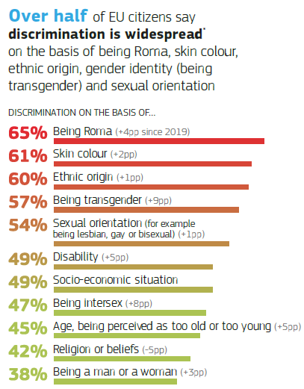
2. IMPACT OF DISCRIMINATION ON DIFFERENT GROUPS
Section 1: Understanding the Impact on Different Groups
According to Eurostat (Eurostat 2023), several groups in Europe face significant discrimination, with widespread prejudicial attitudes present in various countries. Discrimination often stems from difficulty accepting diversity and primarily targets:
The most frequently mentioned forms of discrimination or harassment are based on:
socioeconomic status
age
gender
political opinions
overall physical appearance
Public spaces and workplaces are the main settings where these discriminatory behaviours or harassment occur.
The Romani community (65%)
Skin colour (61%)
Ethnic origin (60%)
Gender identity (being transgender, 57%)
Sexual orientation (54%)
Source: https://europa.eu/eurobarometer/surveys/detail/2972

Slide 12
2. IMPACT OF DISCRIMINATION ON DIFFERENT GROUPS
Section 1: Understanding the Impact on Different Groups
E.g. Impact of Socio-Economic Inequalities on Education
Individuals in disadvantaged socio-economics conditions face significant challenges due to limited opportunities inherent in their situation. This difficulty is compounded by widespread societal discrimination. Such discrimination is often rooted in a combination of prejudices and stereotypes.
For example, people might judge someone's potential work capabilities based on their background or assume that those from socio-economically disadvantaged backgrounds are less educated. These prejudices and stereotypes further exacerbate the barriers faced by these individuals.
We can take as an example the macro group of those living in disadvantaged socio-economic conditions.

Slide 13
2. IMPACT OF DISCRIMINATION ON DIFFERENT GROUPS
Section 2: Terminology and its Effects
About a century ago, the American writer Mark Twain, in the satirical volume Letters from the Earth, presents an experiment conducted by Satan to investigate intolerance among humans (Rational Animals) and the other animals:
In one hour, I taught a cat and a dog to be friends. I put them in a cage. In another hour, I taught them to be friends with a rabbit. Over the course of two days, I managed to add a fox, a goose, a squirrel, and some doves, and eventually even a monkey. They lived together in peace, even affectionately. Then, in another cage, I confined an Irish Catholic from Tipperary, and as soon as he seemed tame, I added a Scottish Presbyterian from Aberdeen. Then a Turk from Constantinople, a Greek Christian from Crete, an Armenian, a Methodist from the wilds of Arkansas, a Buddhist from China, and a Brahmin from Benares. Finally, a Salvation Army Colonel from Wapping. At this point, I left for two whole days. When I returned to observe the results, everything was fine in the cage with the Superior Animals, but in the other one—full of humans—there was such a bloody chaos that only bits and pieces of turbans, fezzes, kilts, bones, and flesh could be distinguished: not a single specimen had survived. These Rational Animals could not agree on a theological detail and had brought the matter before a Supreme Court (Letters from the Earth,Twain, 1962, pp. 180-181).
Twain’s example shows how labels shape social dynamics and discrimination. While animals live peacefully without categories, humans, divided by labels, face conflict. Labels create divisions, fuelling prejudice. So, to foster inclusion, using respectful language is essential.

Slide 14
2. IMPACT OF DISCRIMINATION ON DIFFERENT GROUPS
Section 2: Terminology and its Effects
" I'm not racist but…" How many times have we heard this phrase? Despite progress against discrimination, there is still a long way to go. Stereotypes carry cultural and psychological connotations that shape social perceptions. Once associated with a group, they influence every judgment about it.
Even seemingly harmless statements like "I'm not racist but…" perpetuate stereotypes and prejudices, reinforcing divisions and inequalities. Discriminatory terminology fosters feelings of exclusion and legitimizes discriminatory behaviour.
Using respectful and inclusive language is not just political correctness but a form of EDUCATION and RESPECT, essential for building a more equitable and just society.
"Persuasive are stereotypes, words that contain many cultural, psychological, and emotional connotations: all simplifications, but all very well etched in the collective imagination. Once applied, these sticky words convey any other judgment within the framework they create." — Matteo Rampin

Slide 15
2. IMPACT OF DISCRIMINATION ON DIFFERENT GROUPS
Section 3: Case Study
SOCIO-ECONOMIC TERMINOLOGY AND ITS IMPACT
BRIEF CONTEXT: | "Marko, a skilled labourer from a rural village in an economically underprivileged region of Eastern Europe, relocates to a metropolitan area in search of better employment opportunities."
SITUATION: | Despite being highly experienced, Marko encounters biased perceptions during job interviews in the city. KEY QUOTE: "Given your rural background, are you comfortable working in a high-demand, professional environment?"
POWER OF WORDS: | Terminology used in professional settings can either open doors or reinforce existing barriers. Language that reflects stereotypes and prejudices can lead to unfair treatment and missed opportunities. Discriminatory terminology not only reflects existing biases but also perpetuates them, influencing perceptions and decisions at both individual and systemic levels."

Slide 16
Unit 3
ENGAGING TARGET GROUPS EFFECTIVELY

Slide 17
3. ENGAGING TARGET GROUPS EFFECTIVELY
Section 1: Fostering Empathy and Respect
To overcome the limits built from stereotypes and prejudices, it is necessary to start with two fundamental tools:
EMPATHY | RESPECT
It comes from the Greek empateia and it means 'feel within another’.
It is “an emotional response directed towards the other, consistent with the perception of his well-being” (Bateson).
This helps us to create a kind of invisible thread that connects us with the other individuals, regardless of its characteristics. Empathy must therefore guide us in:
Taking the perspective of the other.
Recognize the emotions of others.
Respond appropriately to the emotions of others.
When we deeply understand the feelings and experiences of another person, we automatically develop genuine respect for their individuality and experiences. Inducing empathy towards members of stigmatized groups not only reduces prejudice, but also leads to recognise and respect their differences, seeing the shared humanity that unites us.

Slide 18
3. ENGAGING TARGET GROUPS EFFECTIVELY
Section 1: Fostering Empathy and Respect
Empathy and Respect must therefore be the starting point for breaking the chain of stereotypes and embracing diversity. There are 3 basic points to start from to turn empathy into an integration weapon:
Intercultural Empathy: A powerful way to dismantle the barriers created by stereotypes is through intercultural empathy. By actively seeking to understand and appreciate diverse cultures and perspectives, we challenge our preconceived notions and dismantle harmful stereotypes.
Dialogue and Respect: This approach involves engaging in open, respectful dialogue, fostering genuine connections, and recognizing the inherent value of diversity.
Self-Reflection on Biases: Individuals must engage in self-reflection to identify and confront their own biases and stereotypes. By acknowledging and challenging our assumptions, we can become more empathetic and open-minded.

Slide 19
3. ENGAGING TARGET GROUPS EFFECTIVELY
Section 2: Active Listening Skills
In a world where differences can often become barriers, active listening offers a path to overcoming divisions. It is a communication skill that goes beyond simply hearing words. It involves actively processing, understanding and responding to the speaker's message, both verbal and non-verbal.
By being fully present and aware during conversations, active listening allows us to deeply connect with others, understanding their emotions and perspectives. This fosters empathy.
Active listening also enables us to show respect by valuing the other person's words, ideas, and emotions. This helps the speaker feel understood and close to us, regardless of the factors that unite or separate us, thereby bridging the gap created by diversity.

Slide 20
3. ENGAGING TARGET GROUPS EFFECTIVELY
Section 2: Active Listening Skills
Active listening techniques help bridge gaps between people by fostering empathy and respect. They enable connection with the speaker's emotions, validate their experiences and build respectful dialogue through careful listening and responses.
A. Suspend judgment and show open-mindedness when interacting with people from different cultures, backgrounds or experiences. Instead of forming an opinion or judgment immediately, listen carefully and ask questions that explore the unique perspectives of the other person. This practice encourages understanding and fosters inclusivity.
B. When discussing experiences related to diversity, an effective active listening technique is to create a bridge between what the other person is sharing and your own experiences, without diminishing or overshadowing their story. This approach not only demonstrates empathy but also strengthens the sense of connection by acknowledging both the similarities and differences in individual experiences.
C. Ask open-ended questions instead of limiting yourself to questions that require just a "yes" or "no" answer. This approach demonstrates genuine interest in the thoughts and feelings of others, helping to bridge gaps between people and reduce the distance caused by differences.

Slide 21
3. ENGAGING TARGET GROUPS EFFECTIVELY
Section 3: Applying Concepts in Real-Life Situations
SCENARIO: Addressing Stereotypes and Prejudices in Rural Communities Facing Socio-Economic Challenges
CONTEXT: | A rural EU community project supports families in economic hardship, addressing stereotypes of being "backward" or "uneducated" and promoting inclusion through volunteer and social worker efforts.
APPLICATION OF CONCEPTS:
1. Empathy and Respect | Social workers recognize harmful stereotypes, like labeling rural communities as "uneducated" or "incapable." By empathizing with their experiences and respecting their resilience, they shift the narrative from deficits to potential.
2. Active Listening and Inclusive Language | Social workers hold active listening sessions, giving marginalized voices a platform to share concerns and aspirations. Volunteers use inclusive, respectful language to avoid stereotypes and foster a positive self-image within the community.
3. Overcoming Diversity Through Dialogue | The team organizes workshops fostering dialogue between community members and outsiders to challenge stereotypes and promote mutual respect. By emphasizing shared goals, these sessions build unity across socio-economic and cultural divides.

Slide 22
3. ENGAGING TARGET GROUPS EFFECTIVELY
Section 3: Applying Concepts in Real-Life Situations
SCENARIO: Addressing Stereotypes and Prejudices in Rural Communities Facing Socio-Economic Challenges
OUTCOME: | By fostering empathy, respect, active listening, and mindful language, the project challenges stereotypes, promotes coexistence and raises awareness of diversity. The rural community gains self-esteem, empowerment and stronger connections with society, showcasing how thoughtful communication can overcome prejudice and build a more equitable environment. The scenario shows how empathy, respect, active listening, and inclusive language can overcome stereotypes, turning diversity from a challenge into a source of enrichment and positive change.

Slide 23
Self-assessment test
Question 1. What is the origin of stereotypes and prejudices, according to the provided images?
Option a: They are random thoughts that individuals form over time.
Option b: They stem from a cultural background, are passed down and crystallized through socialization.
Option c: They are inherent characteristics of individuals.
Option d: They are learned exclusively during adulthood through personal experiences.

Slide 24
Self-assessment test
Question 1. What is the origin of stereotypes and prejudices, according to the provided images?
Correct option: [b] They stem from a cultural background, are passed down and crystallized through socialization.

Slide 25
Self-assessment test
Question 2. What is the highest level of prejudice on the Allport Scale?
Option a: Antilocution
Option b: Avoidance
Option c: Discrimination
Option d: Extermination

Slide 26
Self-assessment test
Question 2. What is the highest level of prejudice on the Allport Scale?
Correct option: [d] Extermination

Slide 27
Self-assessment test
Question 3. What is the meaning of "empathy"?
Option a: The ability to sympathize with others' struggles.
Option b: A logical response to understand another's perspective.
Option c: An emotional response consistent with perceiving another's well-being.
Option d: Recognizing and fixing others' problems.

Slide 28
Self-assessment test
Question 3. What is the meaning of "empathy"?
Correct option: [c] An emotional response consistent with perceiving another's well-being.

Slide 29
Self-assessment test
Question 4. Which of the following is NOT one of the three basic points to foster empathy and break stereotypes?
Option a: Intercultural Empathy
Option b: Dialogue and Respect
Option c: Self-Reflection on Biases
Option d: Promoting Uniformity

Slide 30
Self-assessment test
Question 4. Which of the following is NOT one of the three basic points to foster empathy and break stereotypes?
Correct option: [d] Promoting Uniformity.

Slide 31
Self-assessment test
Question 5. Which of the following is NOT an active listening technique?
Option a: Suspend judgment and show open-mindedness.
Option b: Interrupt the speaker to offer advice or solutions.
Option c: Discuss experiences related to diversity to build connections.
Option d: Ask open-ended questions to show genuine interest.

Slide 32
Self-assessment test
Question 5. Which of the following is NOT an active listening technique?
Correct option: [b] Interrupt the speaker to offer advice or solutions.

Slide 33
Summing up
Stereotypes and prejudices are shaped by cultural and social influences, passed down through socialisation and can lead to discrimination if unchallenged.
Breaking stereotypes starts with intercultural empathy, dialogue and respect and self-reflection on biases to foster inclusion and diversity.
Prejudice escalates through five levels: antilocution, avoidance, discrimination, physical attack and extermination, showing the dangers of unchecked biases.
Techniques like suspending judgment, discussing diversity experiences and asking open-ended questions help bridge gaps, validate emotions and promote respectful dialogue.

Slide 34
Thanks for your attention!
Explore more resources at www.allin-inclusion.eu

